Slide 1

Digital Design and Verification Training
AXI4Lite Protocol

Slide 2
Agenda
Timing Diagrams for Read and Write operations
Channel Dependency
Handshake Signal Dependency

Slide 3
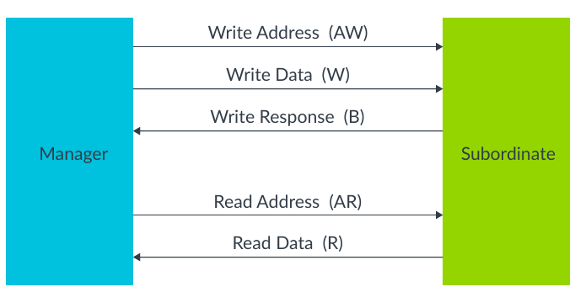
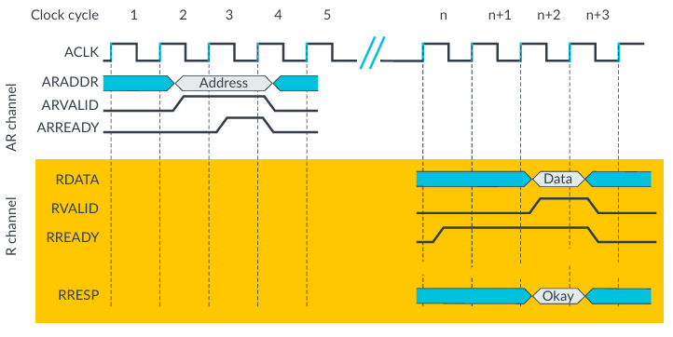
Read Single
Notes:
Use an interface when you want to connect multiple modules with a clean, single port and possibly embed protocol behavior.

Slide 4
Read Single
Notes:
Use a struct when you just need to group related signals inside a module/class.
Use an interface when you want to connect multiple modules with a clean, single port and possibly embed protocol behavior.

Slide 5
Read Single
Notes:
Use a struct when you just need to group related signals inside a module/class.
Use an interface when you want to connect multiple modules with a clean, single port and possibly embed protocol behavior.

Slide 6
Read Single
Notes:
Manager is the source i.e. asserts ARVALID and sub-ordinate is the destination i.e. asserts ARREADY
Use an interface when you want to connect multiple modules with a clean, single port and possibly embed protocol behavior.

Slide 7
Read Single
Notes:
Use a struct when you just need to group related signals inside a module/class.
Use an interface when you want to connect multiple modules with a clean, single port and possibly embed protocol behavior.

Slide 8
Read Single
Notes:
Use a struct when you just need to group related signals inside a module/class.
Use an interface when you want to connect multiple modules with a clean, single port and possibly embed protocol behavior.

Slide 9
Read Single
Notes:
Use a struct when you just need to group related signals inside a module/class.
Use an interface when you want to connect multiple modules with a clean, single port and possibly embed protocol behavior.

Slide 10
Read Single
Notes:
Use a struct when you just need to group related signals inside a module/class.
Use an interface when you want to connect multiple modules with a clean, single port and possibly embed protocol behavior.

Slide 11
Read Single
Notes:
Use a struct when you just need to group related signals inside a module/class.
Use an interface when you want to connect multiple modules with a clean, single port and possibly embed protocol behavior.

Slide 12
Read Single
Notes:
Use a struct when you just need to group related signals inside a module/class.
Use an interface when you want to connect multiple modules with a clean, single port and possibly embed protocol behavior.

Slide 13
Read Single
Notes:
Use a struct when you just need to group related signals inside a module/class.
Use an interface when you want to connect multiple modules with a clean, single port and possibly embed protocol behavior.

Slide 14
Write Single Operation

Slide 15
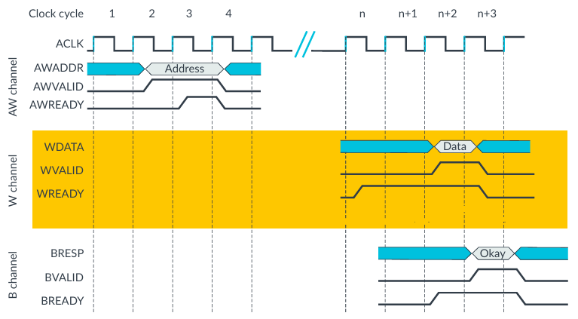
Write Single
Notes:
Use a struct when you just need to group related signals inside a module/class.
Use an interface when you want to connect multiple modules with a clean, single port and possibly embed protocol behavior.

Slide 16
Write Single
Notes:
Use a struct when you just need to group related signals inside a module/class.
Use an interface when you want to connect multiple modules with a clean, single port and possibly embed protocol behavior.

Slide 17
Write Single
Notes:
Use a struct when you just need to group related signals inside a module/class.
Use an interface when you want to connect multiple modules with a clean, single port and possibly embed protocol behavior.

Slide 18
Write Single
Notes:
Use a struct when you just need to group related signals inside a module/class.
Use an interface when you want to connect multiple modules with a clean, single port and possibly embed protocol behavior.

Slide 19
Write Single
Notes:
Use a struct when you just need to group related signals inside a module/class.
Use an interface when you want to connect multiple modules with a clean, single port and possibly embed protocol behavior.

Slide 20
Write Single
Notes:
Use a struct when you just need to group related signals inside a module/class.
Use an interface when you want to connect multiple modules with a clean, single port and possibly embed protocol behavior.

Slide 21
Write Single
Notes:
Use a struct when you just need to group related signals inside a module/class.
Use an interface when you want to connect multiple modules with a clean, single port and possibly embed protocol behavior.

Slide 22
Write Single
Notes:
Use a struct when you just need to group related signals inside a module/class.
Use an interface when you want to connect multiple modules with a clean, single port and possibly embed protocol behavior.

Slide 23
Write Single
Notes:
Use a struct when you just need to group related signals inside a module/class.
Use an interface when you want to connect multiple modules with a clean, single port and possibly embed protocol behavior.

Slide 24
Write Single

Slide 25
Write Single

Slide 26
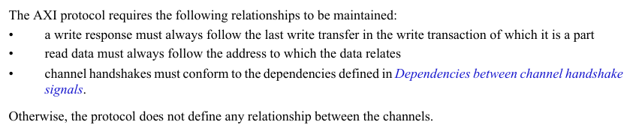
Channel Relationships
Notes:
Use a struct when you just need to group related signals inside a module/class.
Use an interface when you want to connect multiple modules with a clean, single port and possibly embed protocol behavior.

Slide 27
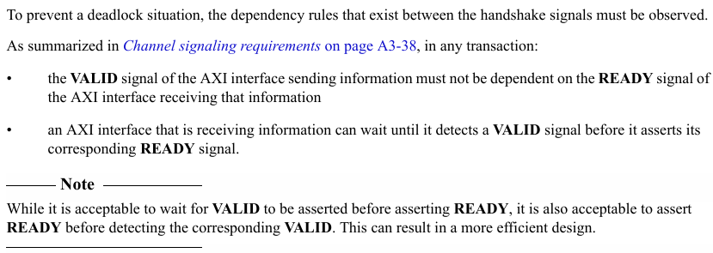
Channel Relationships

Slide 28
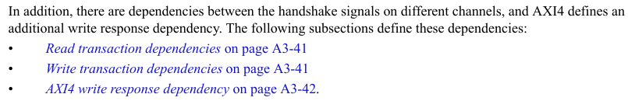
Handshake Signals Dependency

Slide 29
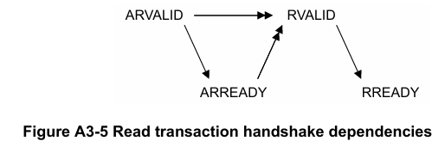
Handshake Signals Dependency
Notes:
RVALID can be asserted only after asserting ARVALID and ARREADY i.e. RVALID can be asserted after address transferred to destination
Use an interface when you want to connect multiple modules with a clean, single port and possibly embed protocol behavior.

Slide 30
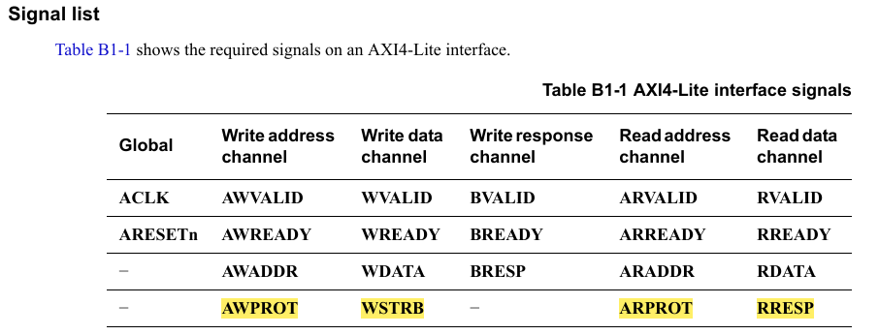
AXI4LITE Interface Signals
Notes:
Use an interface when you want to connect multiple modules with a clean, single port and possibly embed protocol behavior.

